Slide 1
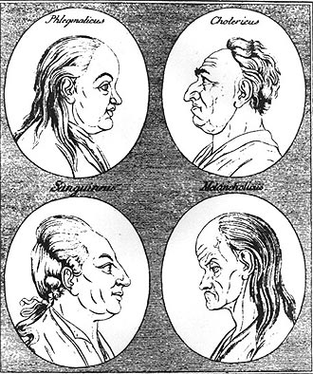
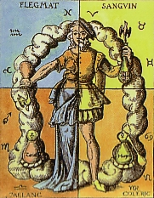
The Four Humours

Slide 2
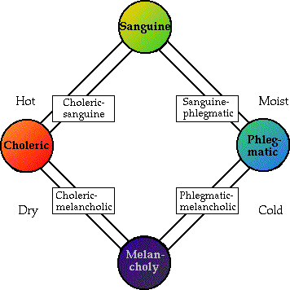
The Four Humours = balance

Slide 3
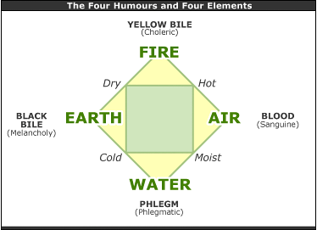

Slide 4
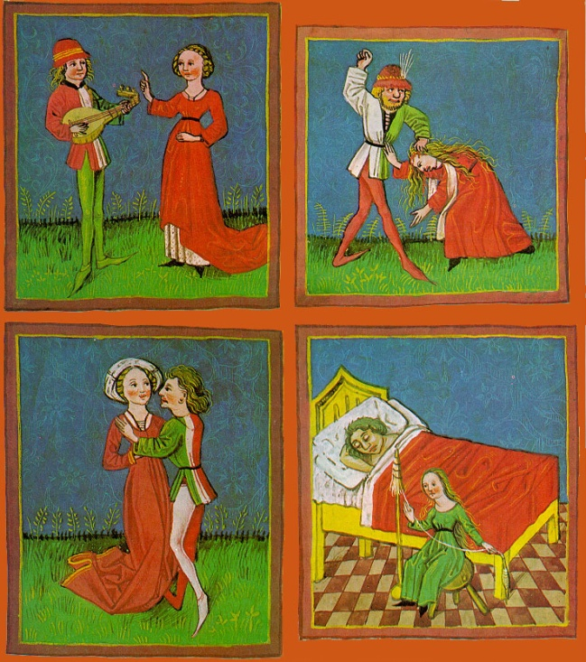
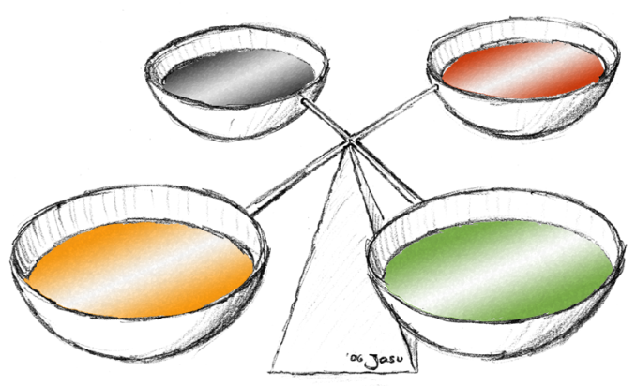
Four Humours
Developed as medical "science" by the ancient Greeks
The Four Humours in Renaissance and Elizabethan time had become standardised as follows:

Slide 5
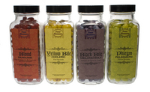
Sanguine
Body substance: blood
produced by: liver
Element: air
Qualities: hot and moist
Complexion and Body type: red-cheeked, corpulent
Personality: amorous, happy, generous, optimistic, irresponsible

Slide 6
Sanguine
Planet: Jupiter
Astrological sign: Gemini, Libra, Aquarius
Direction: South
Season: Spring
Phase of Life: Adolescence
When out of balance: Irresponsible, gluttonous, inebriate, lusty

Slide 7
Choleric
Body substance: yellow bile (includes gall and urine) as in "pissed off"
produced by: spleen
Element: fire
Qualities: hot and dry
Complexion and Body type: red-haired, thin
Personality: violent, vengeful, short-tempered, ambitious

Slide 8
Choleric
Planet: Mars
Astrological sign: Aries, Leo, Sagittarius
Direction: West
Season: Summer
Phase of Life: Adulthood
When out of balance: Violent, hot-tempered, unscrupulous, vengeful

Slide 9
Phlegmatic
Body substance: phlegm (snot, tears)
produced by: lungs
Element: water
Qualities: cold and moist
Complexion and Body type: corpulent
Personality: Sluggish, pallid, cowardly

Slide 10
Phlegmatic
Planet: Moon
Astrological sign: Cancer, Scorpio, Pisces
Direction: East
Season: Winter
Phase of Life: Childhood (also senility)
When out of balance: Lazy, vulnerable, cowardly, excessively emotional

Slide 11
Melancholic
Body substance: black bile (feces, clotted blood)
produced by: gall bladder
Element: earth
Qualities: cold and dry
Complexion and Body type: sallow, thin
Personality: Introspective, sentimental, gluttonous

Slide 12
Melancholic
Planet: Saturn
Astrological sign: Taurus, Virgo, Capricorn
Direction: North
Season: Autumn
Phase of Life: Old Age
When out of balance: Depressive, narcissistic, self-loathing

Slide 13
