Slide 1
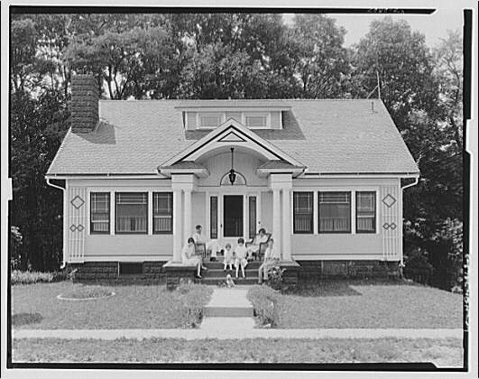
The American Dream
ENG 4U0
Ms. Holland

Slide 2
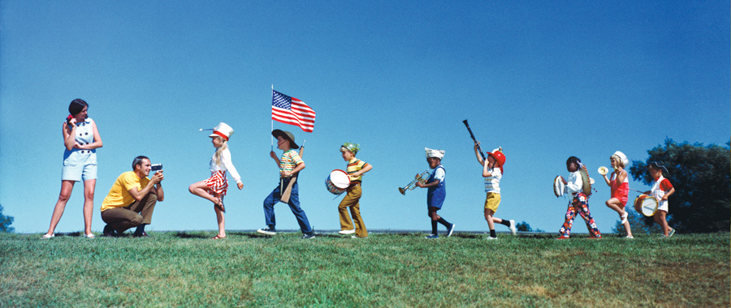
So, just what is the American Dream?
With a partner, create a list of people who have successfully obtained the American Dream?
Decide what qualities they share in common and list those too.

Slide 3
So, just what is the American Dream?
Successful American Dreamers share in common:
Wealth
Fame
Property
Education
Entrepreneurship
Celebrity
Good Luck
Hard WorK
Happiness

Slide 4
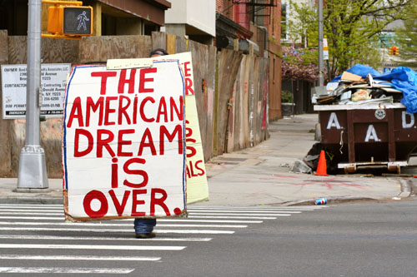
Okay, so what is NOT the American Dream?
With your partner, make a list of people who have failed to obtain the American Dream.
What qualities do FAILED American Dreamers share?

Slide 5
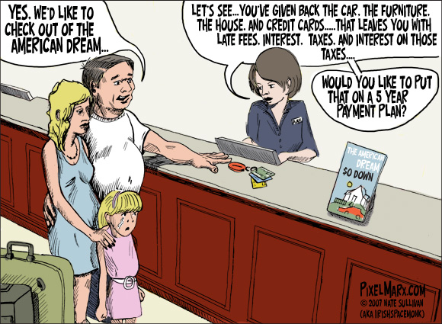
Okay, so what is NOT the American Dream?
Failed dreamers share some of the following qualities:
Poverty
Mental illness
Depression
Unemployment
Laziness (one of the seven deadly sins)
Bad luck
Uneducated

Slide 6
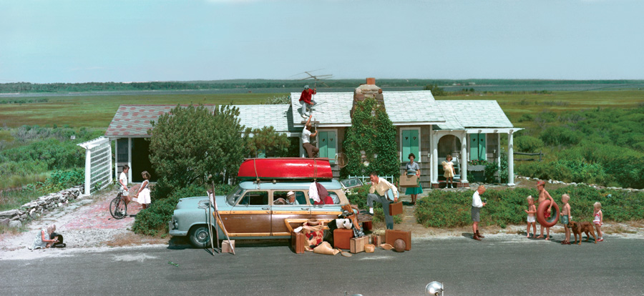
The American Dream Defined:
Random House Dictionary:
“the ideals of freedom, equality, and opportunity traditionally stressed as available to individuals in the United States”

Slide 7
The American Dream Defined:
Webster’s Dictionary:
“An American social ideal that stresses egalitarianism and especially material prosperity.”

Slide 8
The American Dream Defined:
James Thurow Adams in The Epic of America defines it as, “That dream of land in which life should be better and richer and fuller for everyone,
with opportunity for each according to ability or achievement.
It is a difficult dream for the European upper classes to interpret adequately, and too many of us ourselves have grown weary and mistrustful of it.
It is not a dream of motor cars and high wages merely, but a dream of social order….”

Slide 9
The American Dream Defined:
In the American “Declaration of Independence”, Jefferson wrote,
“We hold these truths to be self-evident,
that all men are created equal,
that they are endowed by their Creator with certain inalienable rights,
that among these are Life, Liberty, and the pursuit of Happiness.”

Slide 10
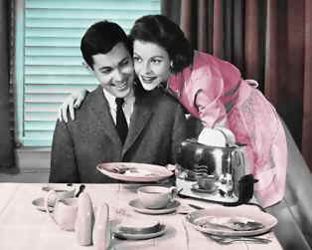
The American Dream Defined:
On July 4, 1965 – two years after his “I have a Dream” speech, Dr. Martin Luther King told an Atlanta congregation: “[The Declaration of Independence] doesn’t say ‘some me’, it says ‘all men’. It doesn’t say ‘all white men’, it says ‘all men’, which includes black men. It does not say ‘all Gentiles’, it says ‘all men’, which includes Jews. It doesn’t say ‘all Protestants’, it says ‘all men’, which includes Catholics. It doesn’t even say ‘all theists and believers’, it says ‘all men, which includes humanists and agnostics.”

Slide 11
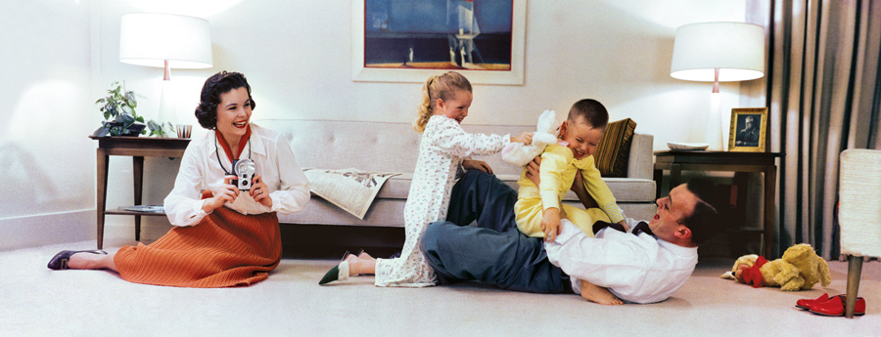
The American Dream Defined:
What do these definitions have in common?
How are they different?

Slide 12
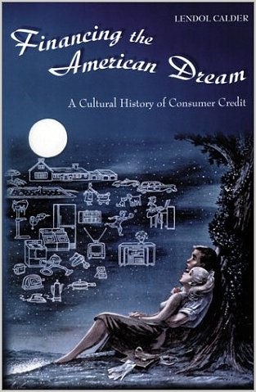
The American Dream Defined:
If the American Dream is an “ideal”, does that mean, like our nighttime reveries, it is not real?
Does anybody ever realize this real?

Slide 13
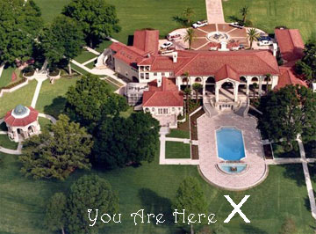
If the American Dream is attainable…
How do we measure how successful or how unsuccessful people are at achieving it?
Fame and fortune?
Power?
Reputation?
Happiness?

