Slide 1
REVIEW OF FORM
LITERARY TERMS

Slide 2
TONE
Tone, in written composition, is an attitude of a writer toward a subject or an audience. Tone is generally conveyed through the choice of words or the viewpoint of a writer on a particular subject.
Every written piece comprises a central theme or subject matter. The manner in which a writer approaches this theme and subject is the tone.

Slide 3
TONE
The tone can be formal, informal, serious, comic, sarcastic, sad, and cheerful or it may be any other existing attitudes.

Slide 4
TONE
“I want to ask the authorities what is the big deal? Why do not they control the epidemic? It is eating up lives like a monster.”
“I want to draw the attention of the concerned authorities toward damage caused by an epidemic. If steps were not taken to curb it, it will further injure our community”

Slide 5
TONE
Tone, in a piece of literature, decides how they readers read a literary piece and how they should feel while they are reading it.
It stimulates the readers to read a piece of literature as a serious, comical, spectacular or distressing. In addition, tone lends shape and life to a piece of literature because it creates a mood.
Moreover, tone bestows voice to characters and it throws light on the personalities and dispositions of characters that readers understand better.

Slide 7
IMAGES
It was dark and dim in the forest.
The children were screaming and shouting in the fields.
He whiffed the aroma of brewed coffee.
The girl ran her hands on a soft satin fabric.
The fresh and juicy orange are very cold and sweet.

Slide 8
IMAGES
The function of imagery in literature is to generate a vibrant and graphic presentation of a scene that appeals to as many of the reader’s senses as possible.
It aids the reader’s imagination to envision the characters and scenes in the literary piece clearly.
Apart from the above mentioned function, images , which are drawn by using figures of speech like metaphor, simile, personification, onomatopoeia etc. serve the function of beautifying a piece of literature.

Slide 9
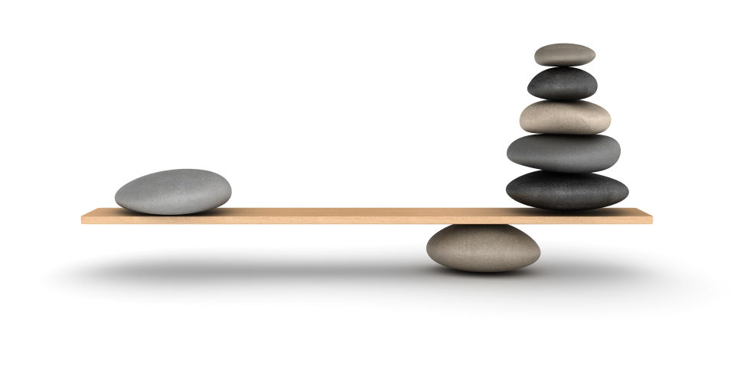
COMPARE
Comparison is a rhetorical or literary device in which a writer compares or contrasts two people, places, things, or ideas. Comparisons occur in literary works frequently.
Writers and poets use comparison in order to link their feelings about a thing to something they compare it with.
There are numerous devices in literature that compare two different things to show the similarity between them e.g. simile, metaphor, analogy etc.

Slide 10
COMPARE (Analogy, Metaphor, Simile)
“All the world’s a stage and men and women merely players,”
“Elderly American ladies leaning on their canes listed toward me like towers of Pisa.”
“The white mares of the moon rush along the sky Beating their golden hoofs upon the glass Heavens.”

Slide 11
COMPARE
Writers utilize different kinds of comparisons to link an unfamiliar or a new idea to common and familiar objects.
Readers to comprehend a new idea, which may have been difficult for them to understand otherwise.
Writers increase their chance of catching the attention and interest of their readers, as comparisons help them identify what they are reading to their lives.

Slide 12
CONTRAST
Contrast is a rhetorical device through which writers identify differences between two subjects, places, persons, things or ideas

Slide 13
CONTRAST
Writers use phrases and words to indicate a contrast such as but, yet, however, instead, in contrast, nevertheless, on the contrary and unlike.

Slide 14
CONTRAST
Point-by-point Contrast – In this type of contrast, writers deal with a series of features of two subjects, and then present their contrast, discussing all points successively.
Subject-by-subject Contrast – In this type of contrast, a writer first discusses one subject thoroughly and then move on to another.

Slide 15
CONTRAST
Through Contrast,
The readers can easily understand through this device what is going to happen next.
Writers make their arguments stronger which become memorable for readers
Writers shock the audience, heighten drama and produce balanced structures in literary works

Slide 16
CONTRAST
To begin with the differences: Lenin was cruel, which Gladstone was not; Lenin had no respect for tradition, whereas Gladstone had a great deal; Lenin considered all means legitimate for securing the victory of his party, whereas for Gladstone politics was a game with certain rules that must be observed. … and accordingly Gladstone on the whole had beneficent effects, while Lenin’s effects were disastrous.
-From “Eminent Men I Have Known, Unpopular Essays” by Bertrand Russell

